Slide 1
Solar Wind Discontinuities: Parker Solar Probe vs ARTEMIS Observations
SPARTHB Zijin Zhang Anton V. Artemyev Vassilis Angelopoulos Chen Shi Zesen Huang

Slide 2
Solar wind discontinuities (SWD)
Discontinuous changes in plasmas parameters and magnetic fields
Import element of solar wind turbulences
Very kinetic structure: interact with energetic part of the solar wind ions

Slide 3
Formation of SWD
Turbulent ion heating by reconnection of tangential discontinuities. (a) Current density (color) and magnetic field lines, possible reconnection sites are indicated by crosses. (b) The proton temperature anisotropy (color) that indicates acceleration
Alfven wave steepening results in the discontinuity formation: magnetic energy transport from large scale (Alfven waves generated in the solar corona) to small (ion kinetic) scales of discontinuities, where this energy can be dissipated to particle heating

Slide 4
Motivation
Studying the radial evolution of solar wind discontinuities from synergistic observations of PSP and Earth-orbiting missions (ARTEMIS, Wind) during aligned intervals.
How does the discontinuities change with the radial distance from the Sun?
How is solar wind discontinuities formed? What is the physical mechanisms?
Generated at or near the sun?
Locally generated in the interplanetary space by turbulence?

Slide 5
In-situ synergistic observations
Similar type of solar wind or Same solar solar wind
How to define alignment?
Trajectory & Orbits (theory): ballistic approximation of Parker spiral
Plasma properties (observation):
Invariants: plasma composition, ionization states, mass flux $nur^{2}$
Correlation: magnetic field / plasma velocity
Simulation: Trace plasma parcels evolution

Slide 6
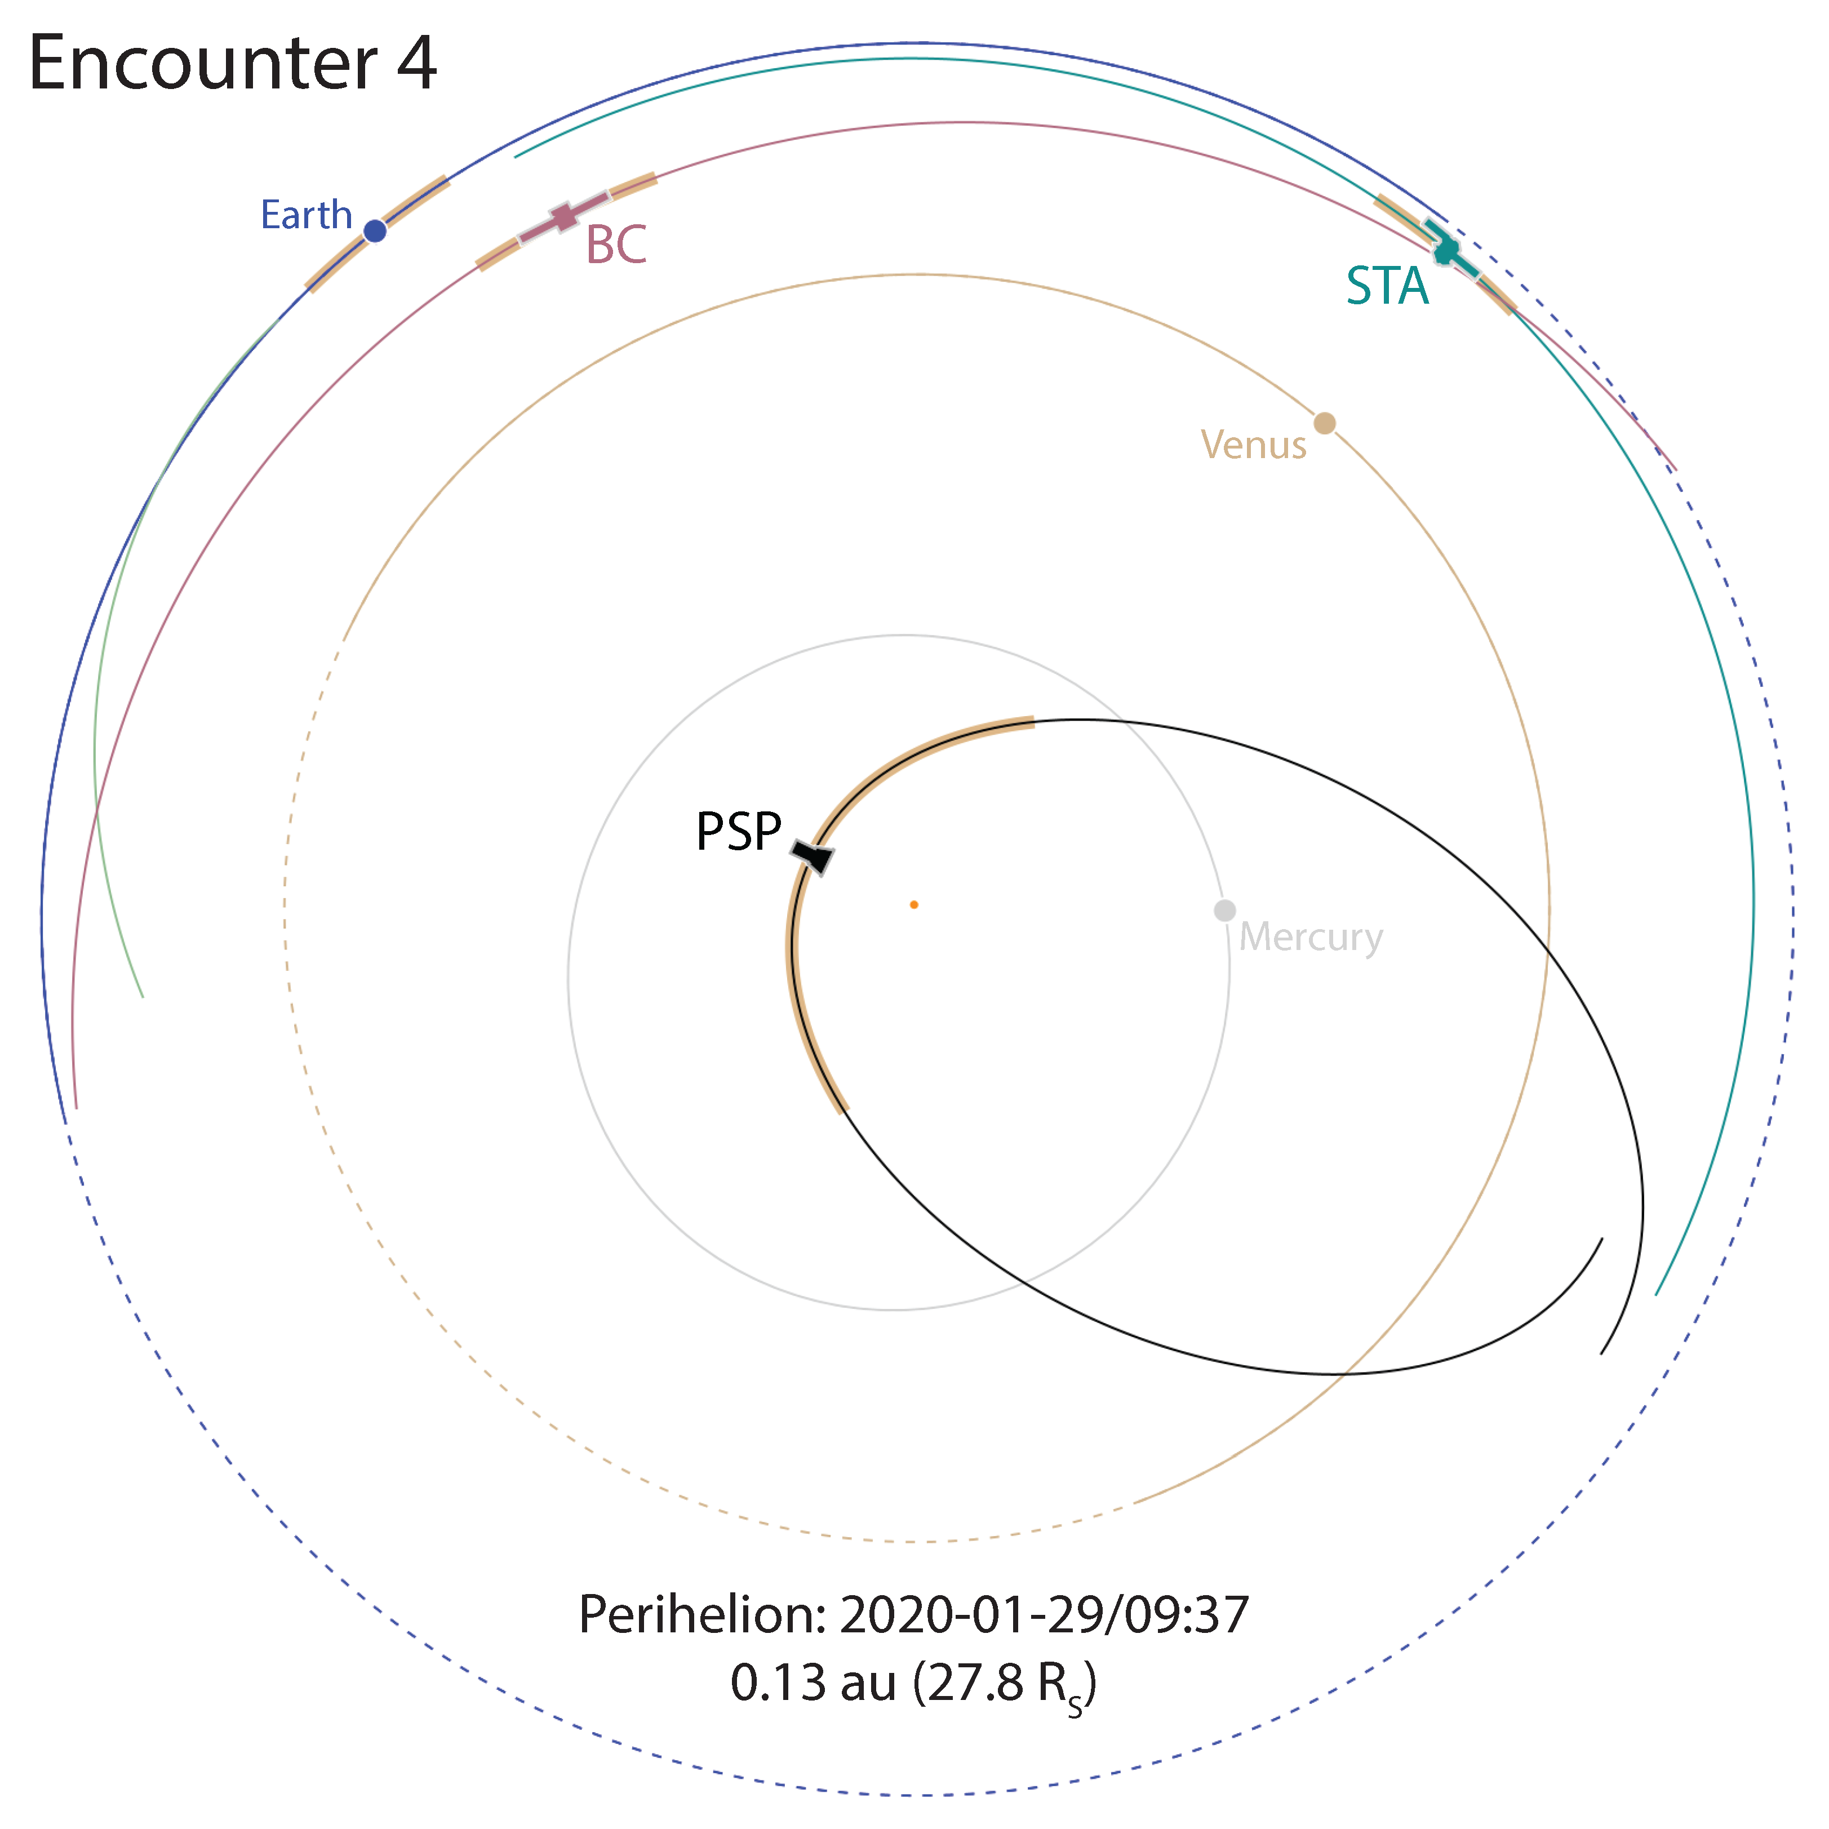
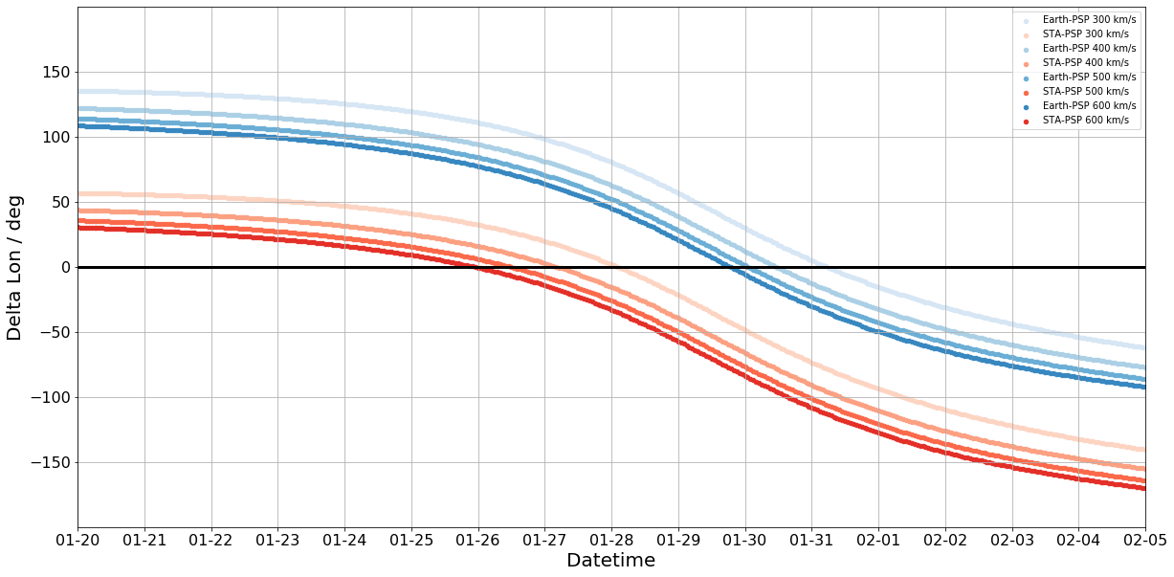
Orbits

Slide 7
ENLIL simulation

Slide 8
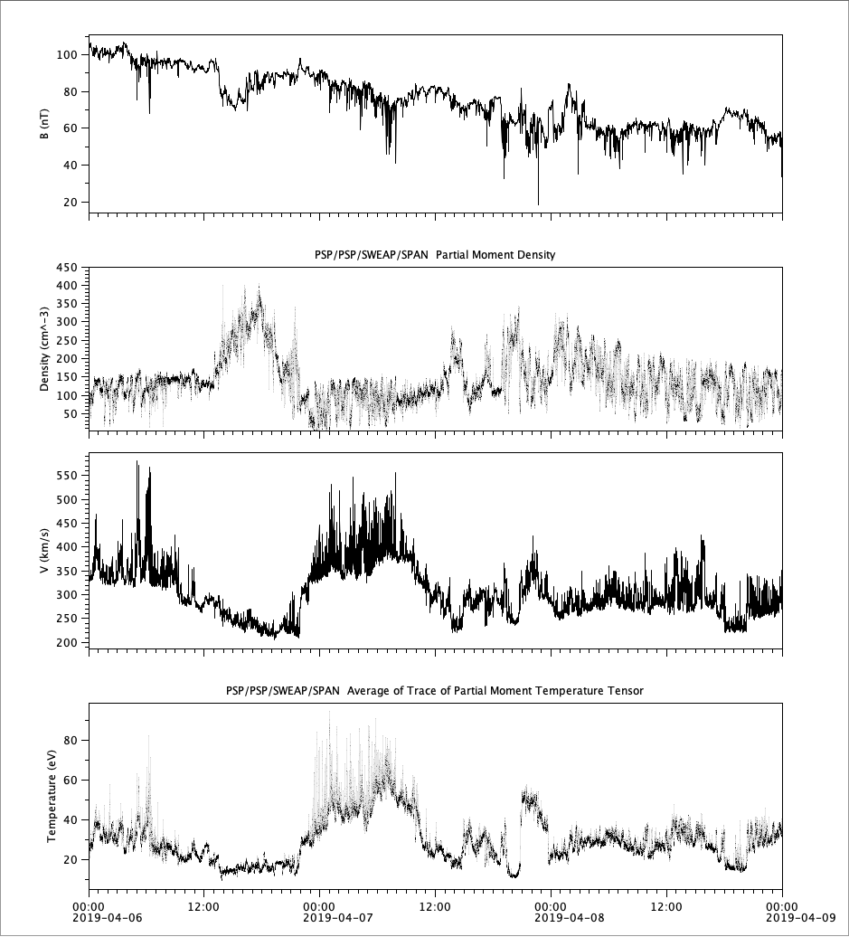
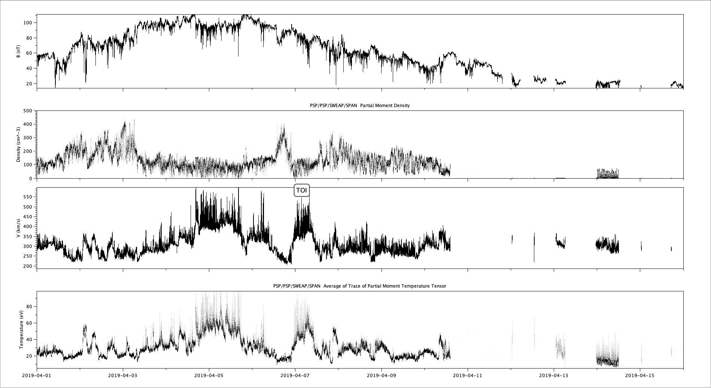
Observation
PSP Observation Overvall
PSP observation

Slide 9
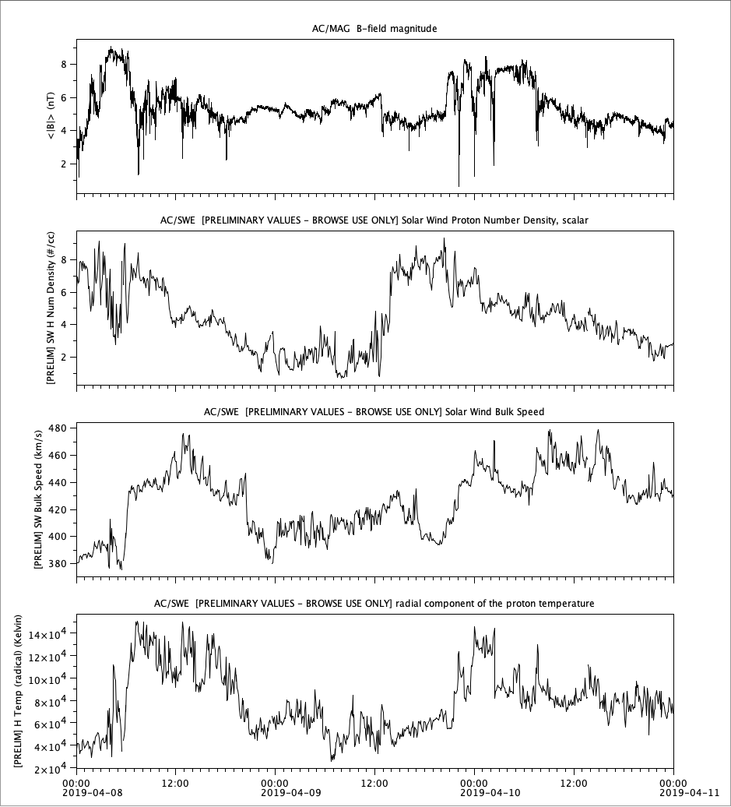
Observation (continued)
PSP observation
ACE observation

Slide 10
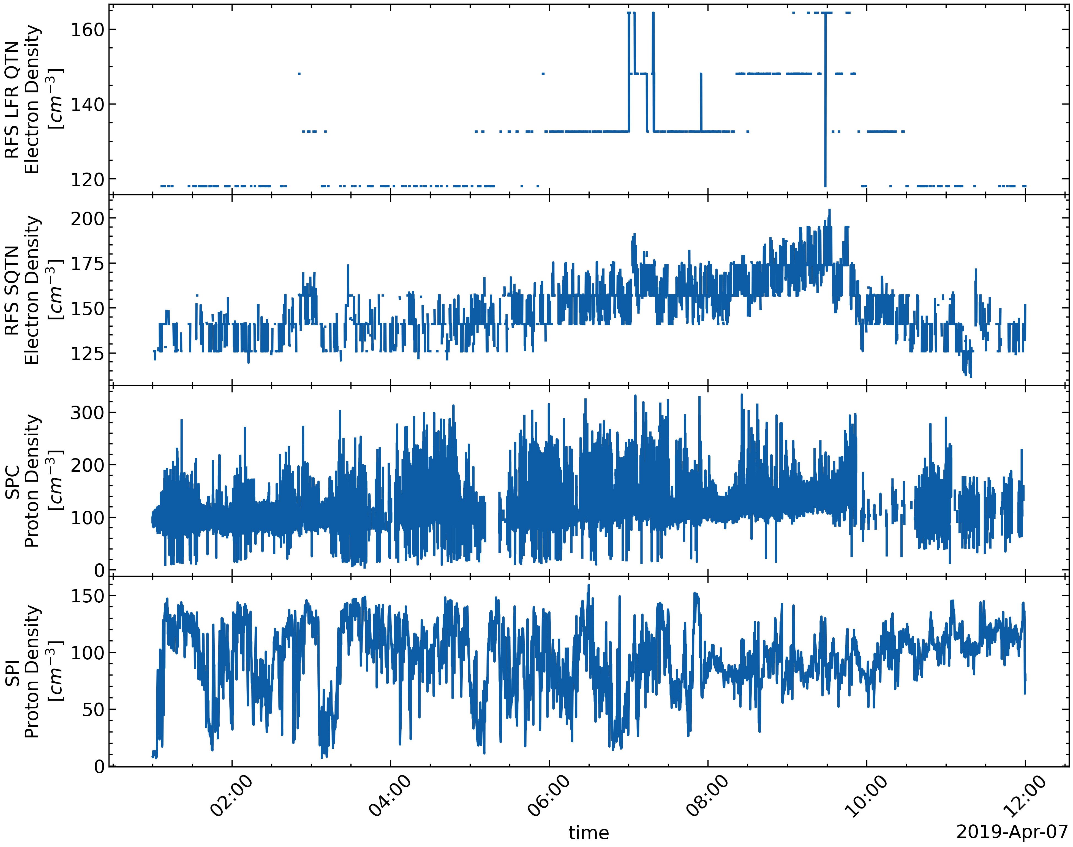
Time resolution (from high to low): SPC, SPI, SQTN, QTN
Quality (fluctuating, from high to low): SQTN, QTN, SPC/SPI
Different Density Product

Slide 11
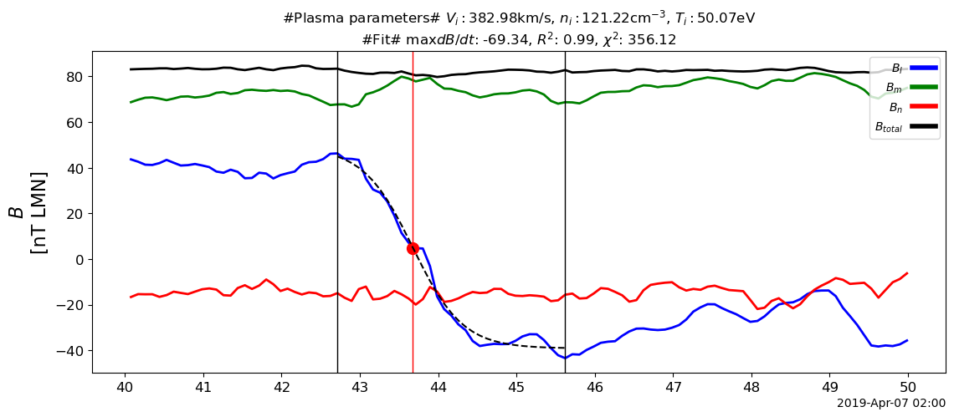
Examples of discontinuities

Slide 12
In general discontinuities observed by PSP are with
shorter duration (1~5 secs)
compared with 5-10 secs
large current density (100-1000 nA/m^2)
compared with 1-10 nA/m^2

Slide 13
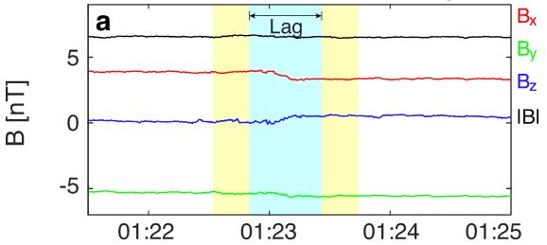
Identification/Detection method

Slide 14
Liu et al. (2022)
Compared with adjacent intervals without sampling

Slide 15
Properties of discontinuities

Slide 16
Every discontinuity’s $l$ component is fitted by a $tanh$ (logistic) function.
Combined with plasma data ($n$, $v$, $T$)
$L$: thickness of the discontinuity
$J_{0}$: maxium current density

Slide 17
If we expect the discontinuities to be generated locally, then the thickness of the discontinuities should be related to local plasma parameters:
Normalize thickness by $d_{i}$ (ion inertial length) or $r_{i}$ (ion gyroradius)
Normalize current density by $J_{A}$ (Alfven current density)

Slide 18
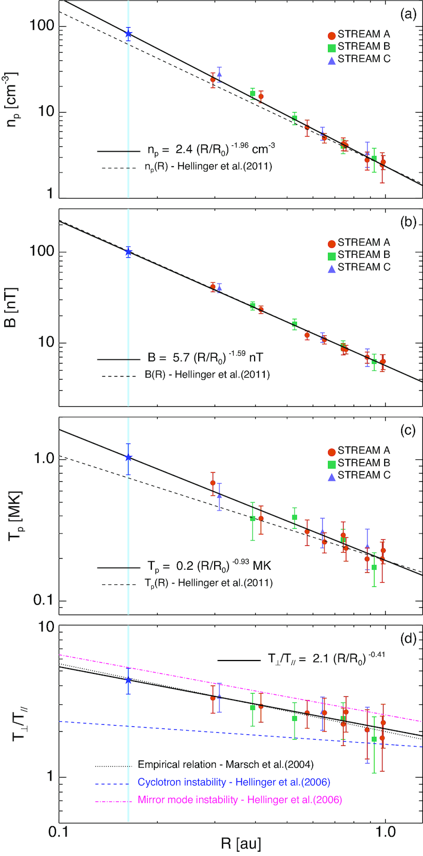
Plasma adiabatic evolution

Slide 19
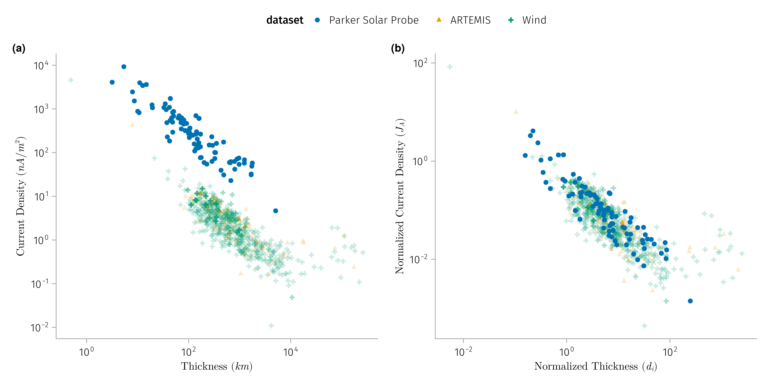
Comparison with discontinuities properties

Slide 20
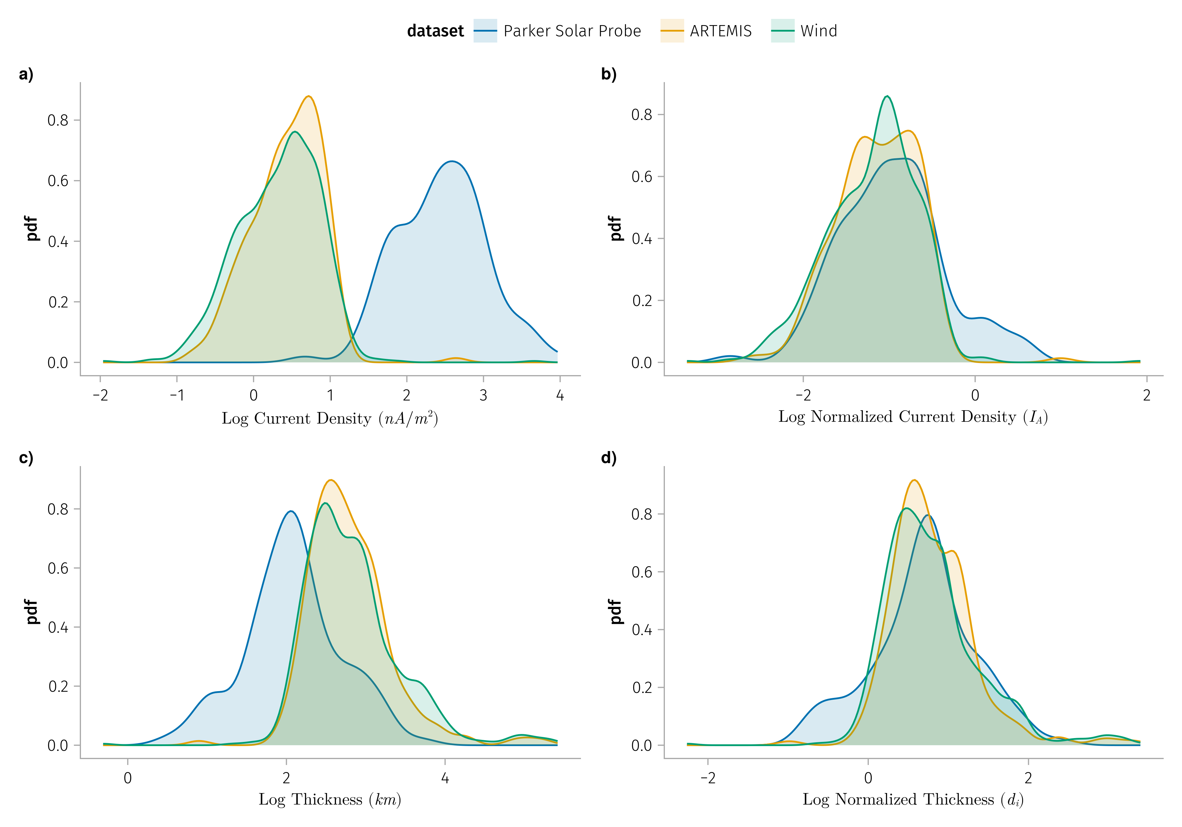

Slide 21
K1: Normalized discontinuities properties does not vary much with radial distance

Slide 22
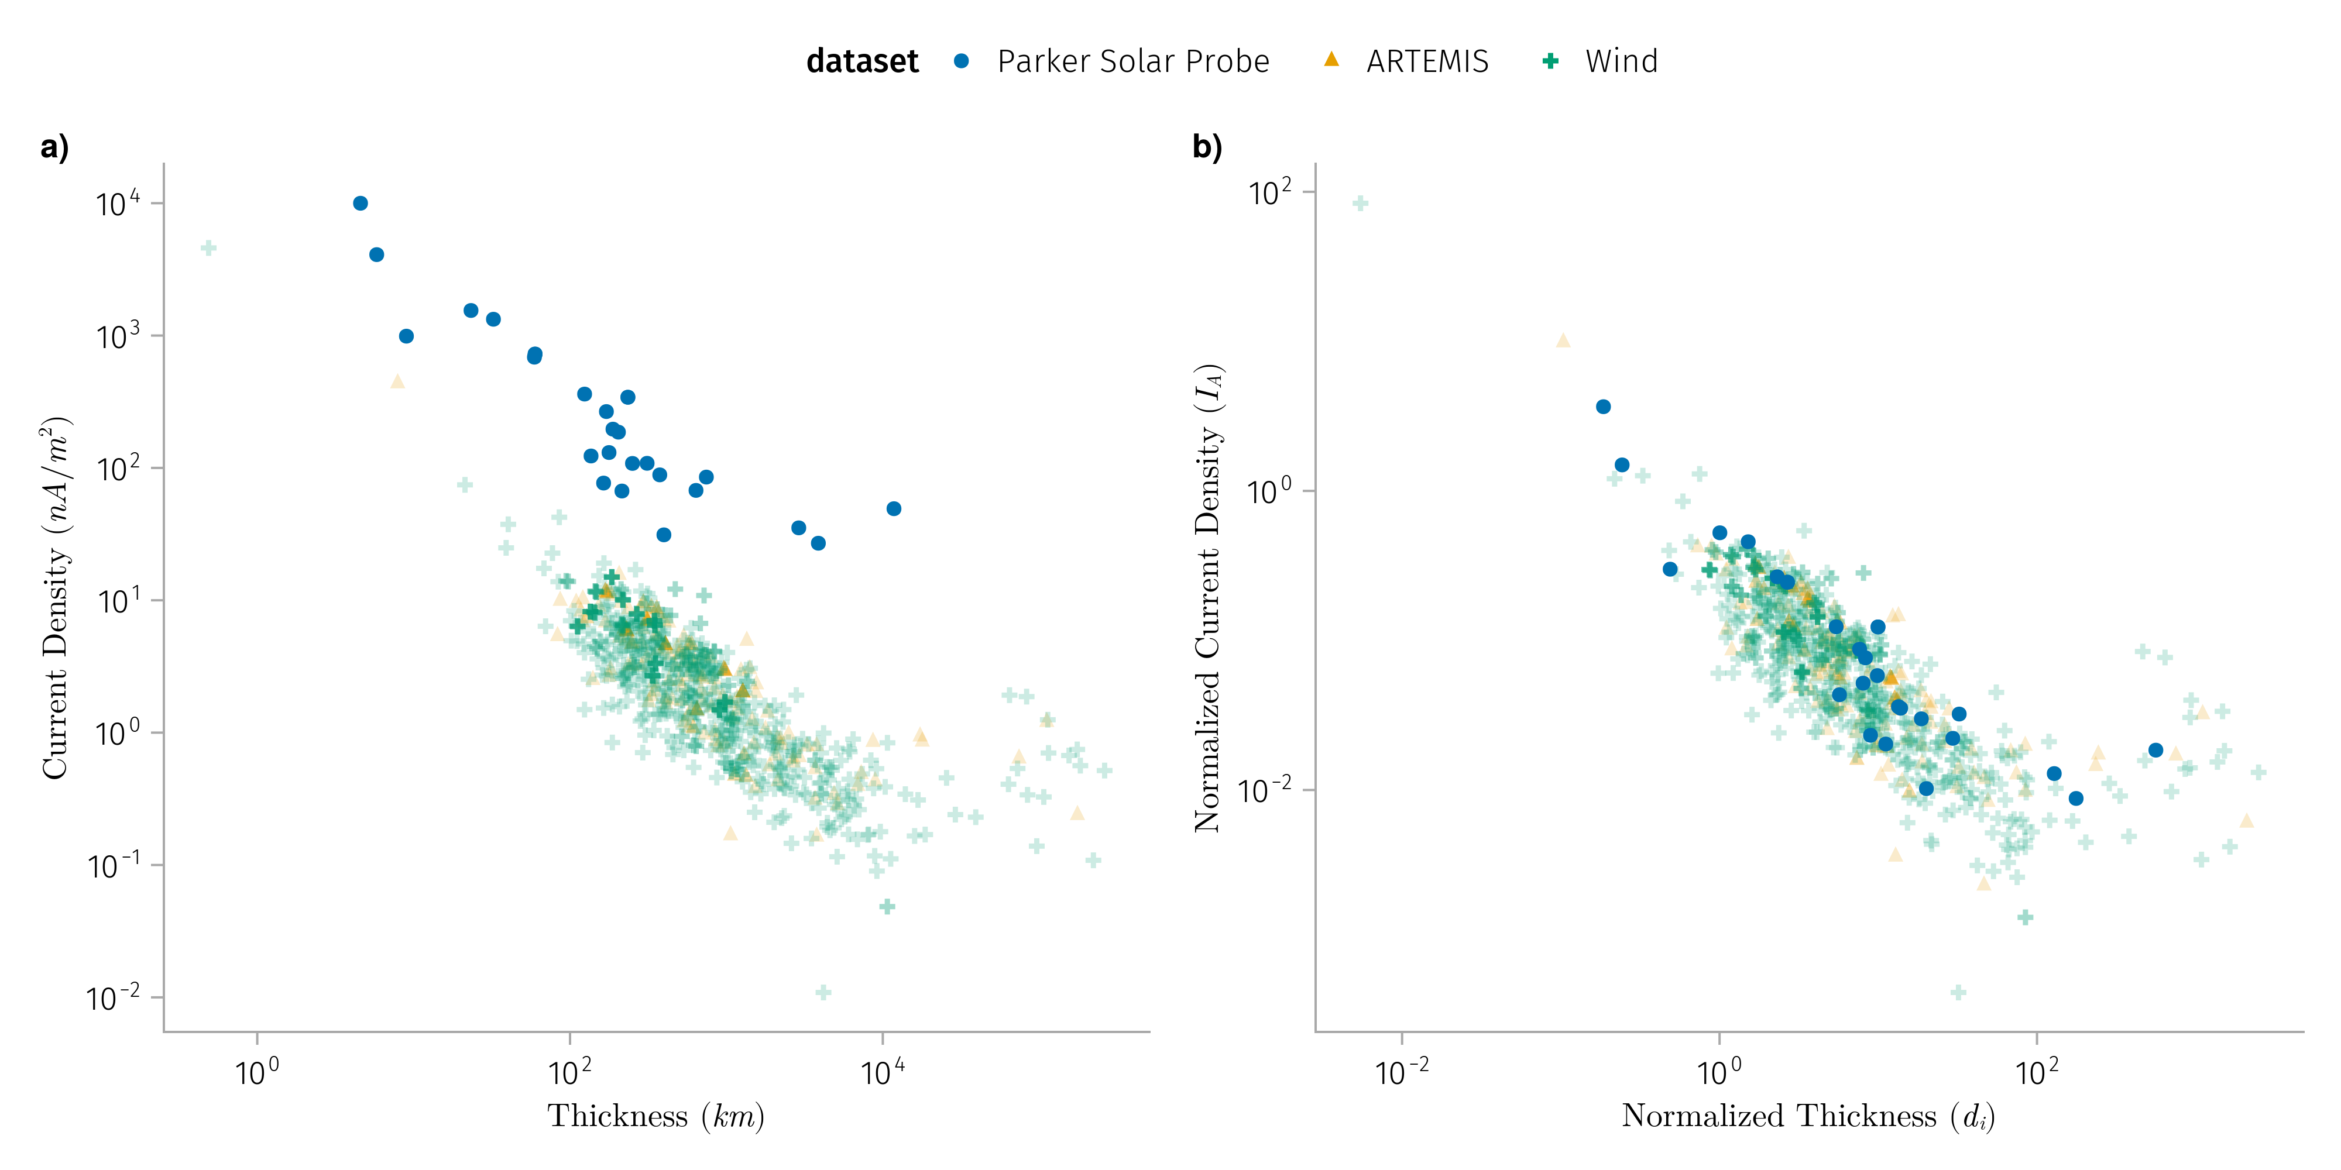

Slide 23
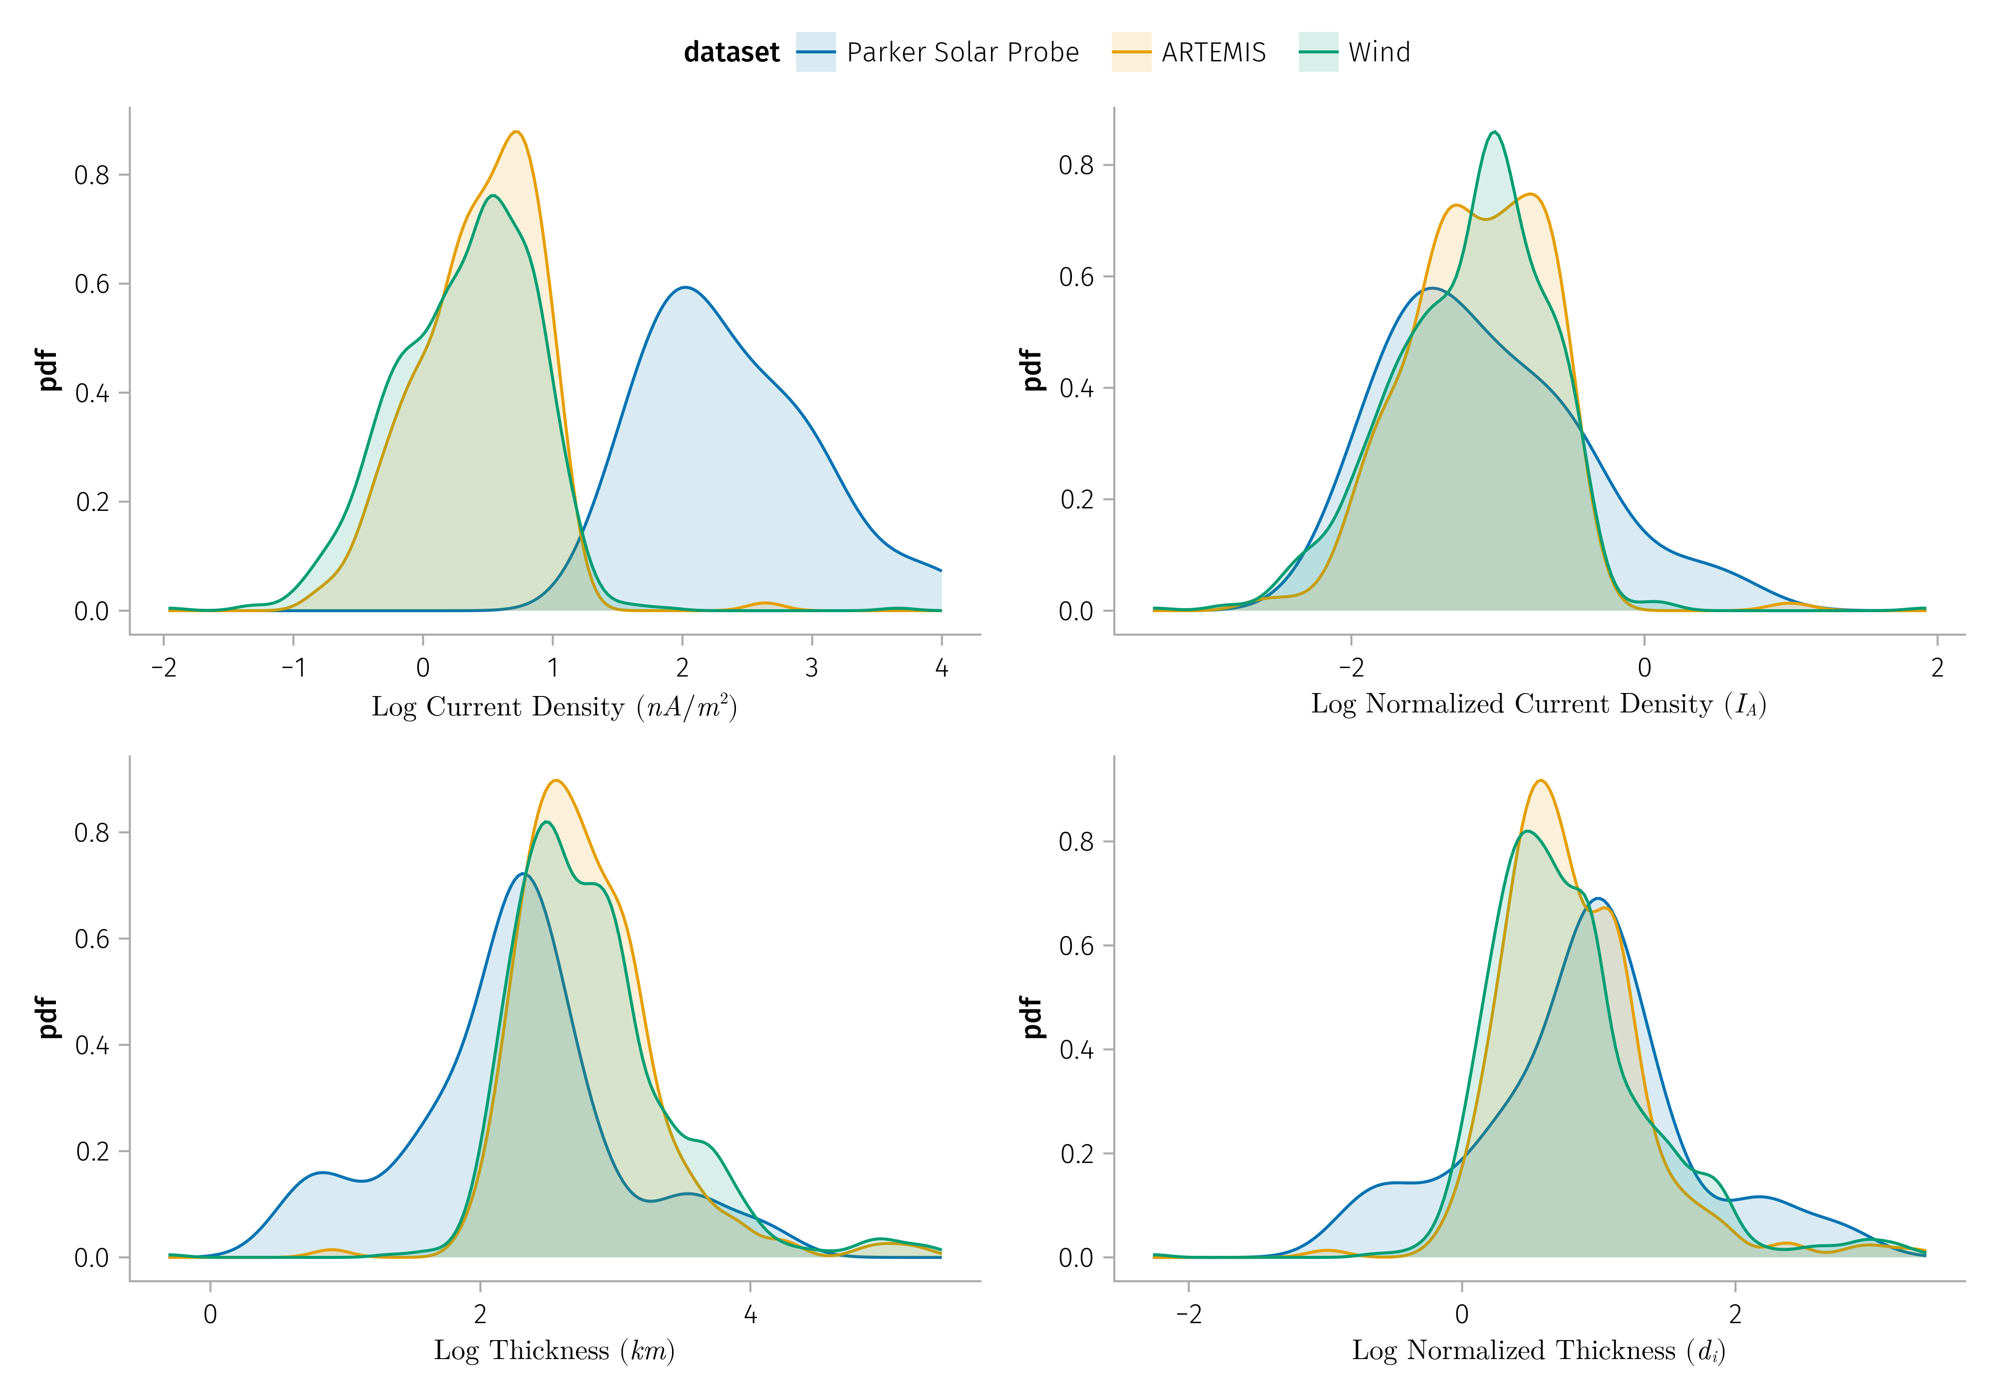

Slide 24
K2: $Δv_{l}$,l demonstrates a strong correlation with $Δv_{A}$, albeit being consistently smaller.

Slide 25
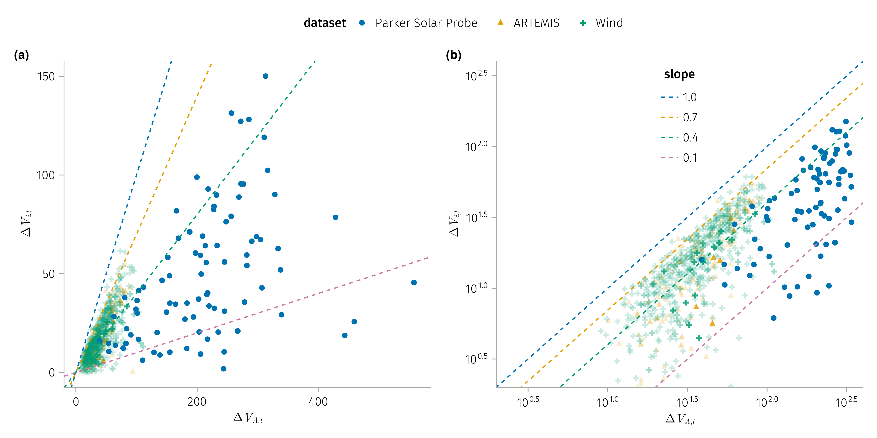
Comparison with Alfven speed and plasma speed change
For rotational discontinuities, the plasma velocity jump across them: the plasma ﬂow velocity $v_{l}$ (the solar wind velocity projected onto $l$) changes due to changes in $B_{l}$, $Δv_{l}=±Δv_{A}$ with $v_{A}=B_{l}/\sqrt{4nm}$ (Hudson 1970).

Slide 26
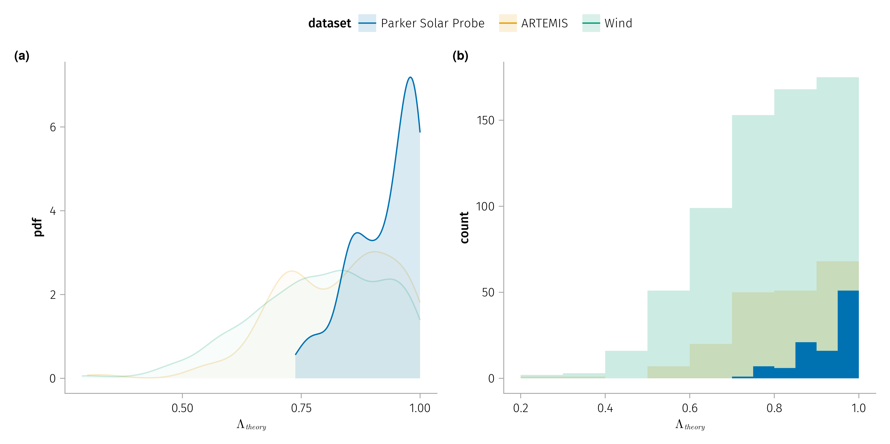
Comparison with anisotropy
The equation for $Δv_{A}$ includes a factor depending on the anisotropy of the plasma.

Slide 27
Pressure anisotropy $Λ=μ\left(P_{∥}−P_{⊥}\right)/B^{2}$.

Slide 28
Conclusion
The properties of the discontinuities is related to the local plasma parameters
Thickness => ion inertial length
Current density => Alfven velocity (current density)
Normalized thickness and current density of discontinuities remain constant with radial distance
Anisotropy of the plasma is expected to be larger near the sun to explain the observed speed change ratio $Δv_{i}/Δv_{A}$.

Slide 29
References
Hudson, P. D. 1970. “Discontinuities in an Anisotropic Plasma and Their Identification in the Solar Wind.” Planetary and Space Science 18 (11): 1611–22. https://doi.org/10.1016/0032-0633(70)90036-X.
Liu, Y. Y., H. S. Fu, J. B. Cao, Z. Wang, R. J. He, Z. Z. Guo, Y. Xu, and Y. Yu. 2022. “Magnetic Discontinuities in the Solar Wind and Magnetosheath: Magnetospheric Multiscale Mission (MMS) Observations.” Astrophysical Journal 930 (1): 63. https://doi.org/10.3847/1538-4357/ac62d2.
Perrone, Denise, D Stansby, T S Horbury, and L Matteini. 2019. “Radial Evolution of the Solar Wind in Pure High-Speed Streams: HELIOS Revised Observations.” Monthly Notices of the Royal Astronomical Society 483 (3): 3730–37. https://doi.org/10.1093/mnras/sty3348.

